Slide 1
Project UI Presentation
By: Ahmet Reşat Demir
Cahit Ediz Civan
Efe Kaan Fidancı
Ghulam Ahmed
Mustafa Kağan Özsoy

Slide 2
About
Our game will be a tower defence strategy game with the aim to prevent enemies from damaging our central core. We will have multiple towers with different attacking features allowing users to protect the center from the enemies. Players will try to keep enemy characters out of their territory as much as possible.

Slide 3
Flow Chart
Starting Screen
Settings
Level Selector
Continue & New Game
Game Music
SFX Sound
Gameplay
End Menu
Pause Menu

Slide 4
Screens
Menu Screen
Game Screen

Slide 5

Menu Screen
Exit to windows button
Play button
Level selection button
Settings button
New game button
(Resets the game progress)

Slide 6
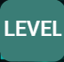
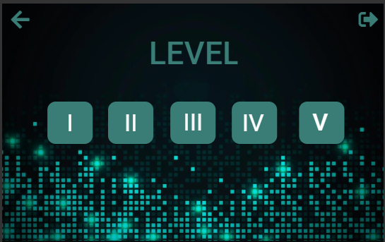
Menu Screen - Subscreen (Level Selector)
Player will select the level by pressing the buttons

Slide 7
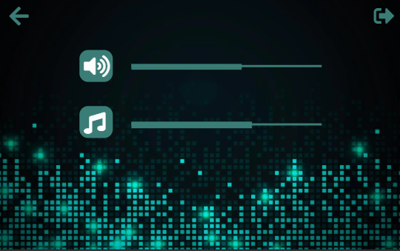
Menu Screen - Subscreen (Settings)
SFX Sound Slider
Game Music Slider

Slide 8
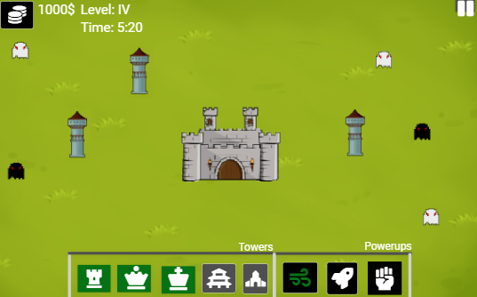
Game Screen
An example demonstration of gameplay interface

Slide 9
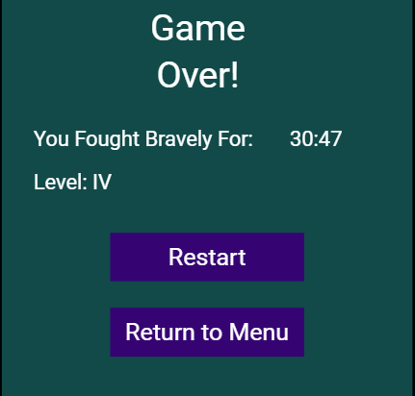
Game Screen - Subscreen (End Menu)
When player fails to defend his/her base
Restarts the current level
Returns the main menu screen

Slide 10
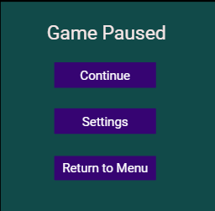
Game Screen - Subscreen (Pause Menu)
After pressing ESC key or pressing pause button
Continues the game
Opens settings window
Returns to main menu screen

Slide 11
User Interface

Slide 12
Level and time indicator
Pause button
Currency indicator

Slide 13
Enemies
Tower
Base

Slide 14
Powerup Indicators
They turn green if they are available to purchase
Tower Indicators
They turn green if they are available to purchase

